Slide 1


Stock Investment Analysis Application
PRODUCED BY
2023

Slide 2

ABOUT APPLICATION

Slide 3
The code will assign a recommended buy/hold/sell based on
stock movements
user-entered data points.
How good of an investment is that?
... Well, let’s find out.
USD
USD
USD
412.01
155.32
2,023.02
We help our users
to be wise investors.
TSLA
SPY
MDDJ

Slide 4
Out Stock Analysis Tool is designed to calculate:
Bollinger Bands
- identify short-term market opportunities.
Monte Carol Simulation
- project return
Sharpe Ratio
- reward to volatility ratio.
Sortino Ratio
- reward to downside volatility ratio
Comparison vs S&P 500

Slide 5
ABOUT US

Slide 6




Our Young and Fabulous Team
Michael Roth
Demi Gao
Diego Favela
Jonny Cruz

Slide 7
ABOUT THE PROCEDURE

Slide 8

Procedure of Tasks
set up our group @2023.01.25
4 group discussions during 3 weeks
1 repo, 5 branches, ( ) files
2 ways of visualization
Step 1
Tasks Modularized
Step 2
Brain Storm
Step 3
Documentation
Step 4
Visualization

Slide 9






Data and libraries we import

Slide 10
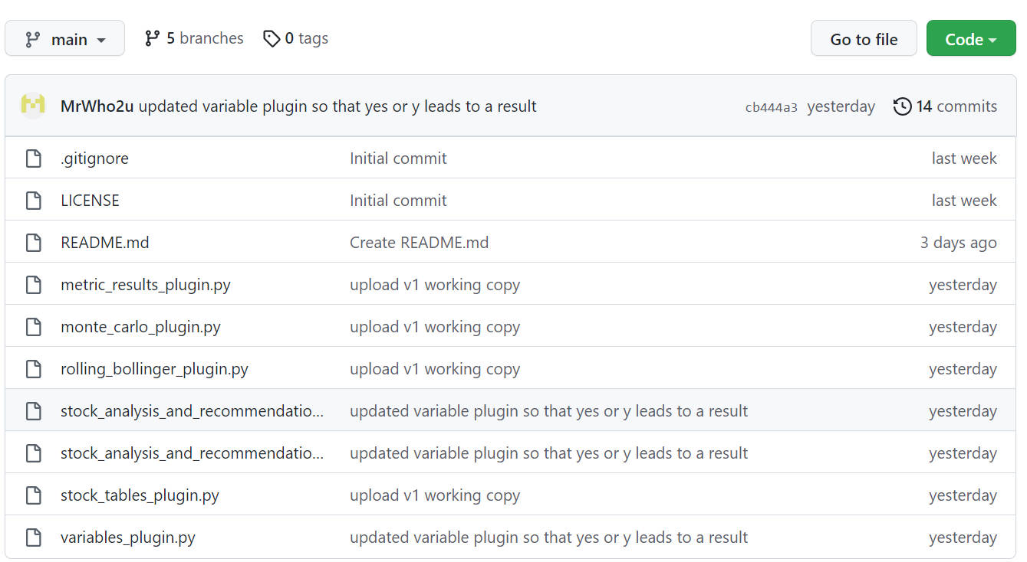
Project
Repo

Slide 11

User Story
As a user,
I hope to use this application to view various useful analysis data and charts of my select stock.
What returns and risk am I taking?
I hope to hold this stock for 15 months.
I hope to get a 7.5% annual return

Slide 12
DEMO

Slide 13
Challenges !
Ensuring users can’t break the process
THANK YOU
FIRAS
KYLE
JENNIFER
FOR YOUR ADVICE AND ENCOURAGE
Creating useful graphs and presentations
Result formatting

Slide 14
Next Steps?

Slide 15
Script can be updated to accommodate the analysis of a portfolio vs a single stock script
Potential
Enhancement
Updates can be made so that a portfolio optimization result is deliver.
Providing the highest risk-adjusted return results weights for a portfolio
Provide the highest risk-adjusted return results of a portfolio and include S&P weight and risk-free weight.
Provide a VAR analysis for holdings

Slide 16
THANK YOU !

